Slide 1
AIRLINE DELAY AND CANCELLATION
PG-DBDA ,CDAC KHARGHAR

Slide 2
Introduction
Passengers may experience difficulty and annoyance as a result of airline delays, which can also have a large financial impact on airlines and airports. So, in order to enhance their operations and cut down on delays, airlines and airports must examine delay data and find patterns and trends.
The information on flight schedules, actual departure and arrival times, the causes of delays, and other pertinent details were gathered from a major airline for inclusion in this report.
The information contains both domestic and international flights throughout the course of a year.
The report will start off by giving a general overview of the data and the analysis techniques. The analysis' findings, including information on delay lengths and causes of delays, will subsequently be presented.
On the basis of the analysis, the report will then offer potential options for minimising delays.
The overall goal of this project is to offer useful insights on airline delays as well as offer workable solutions for enhancing airline operations and decreasing passenger delays.

Slide 3
Research Motivation
The issue of airline delays and cancellations is a significant concern for both airlines and passengers, as it can have a significant impact on financial performance and customer satisfaction.
Delays and cancellations can result in lost revenue, increased costs, and damage to airline reputation. For passengers, delays and cancellations can cause inconvenience, stress, and additional expenses.
Therefore, understanding the causes and patterns of delays and cancellations can provide valuable insights for improving airline operations and customer experience. This research motivation highlights the importance of analyzing airline delay and cancellation data to identify trends, patterns, and potential solutions for enhancing airline performance and reducing the negative impact on passengers.

Slide 4
Problem Statement
Airline Delay and Cancellation is a pervasive problem in the aviation industry that affects not only travelers, but also airlines and airport operators.
Our aim is to create an effective and informative visual representation of flight delay and cancellation data for major US airlines, to identify patterns and insights that can improve air travel.
This will benefit airlines, airports, and passengers by better understanding the factors contributing to delays and cancellations.
We'll be using exploratory analysis and machine learning models to predict airline departure and arrival delays.

Slide 5
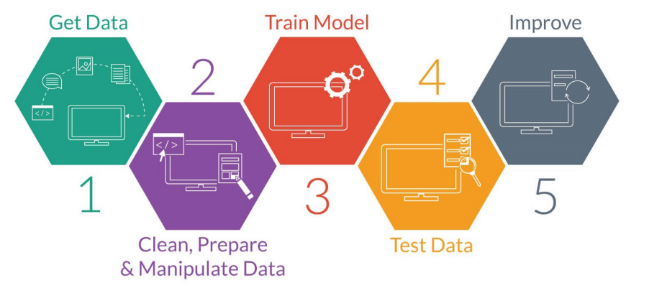
Project development
An overview of the data mining and data modelling process, from data collection to data preparation to data modelling, is provided in this section.
According to numerous data scientists, data cleaning and formatting can be thought of as the most important element of the entire project.
Figure below illustrates how algorithms used in data mining to extract knowledge from a dataset work.

Slide 6
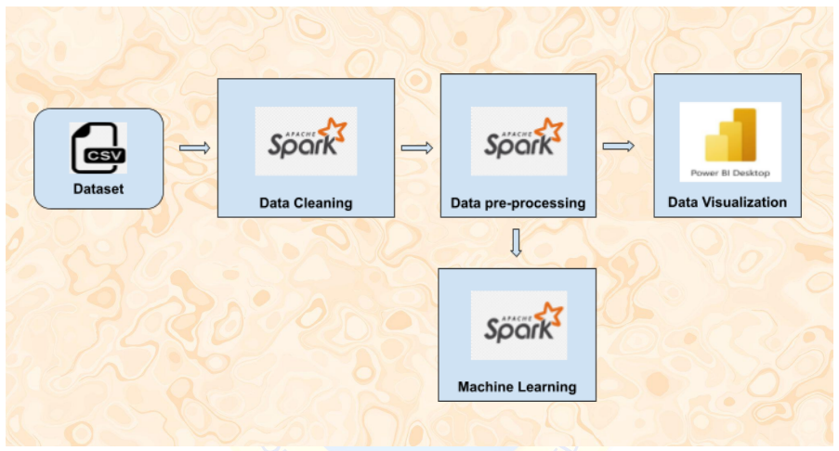
Methodology

Slide 7
Data sources
The data source that we have in the is analysis is a dataset from Kaggle which contains U.S. flight data from 2009-2018. The rows of the dataset represent specific flights from that year, while the columns contain extensive information on the flight such as airline, flight date, departure delay, arrival delay, etc.
Each year's worth of data is contained in a CSV file, totaling about 7 GB for the complete dataset. Moreover, there are roughly 6 million rows in each file. We have decided to just use the data for the year 2018 because we will be conducting research on Anaconda Navigator , which has a RAM and GB constraint.
For our EDA and modelling, this dataset with 7.2 million rows will be adequate; utilising a bigger combined dataset will greatly slow down the training of models and perhaps only slightly improve overall performance.

Slide 8
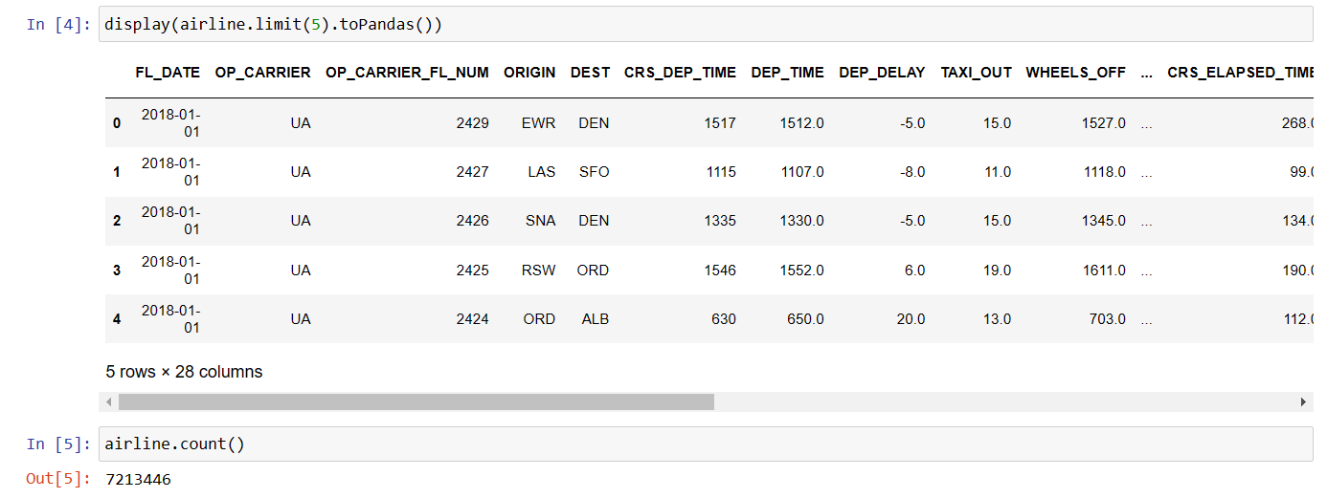
Below is an image of what the dataframe looks like after being read.

Slide 9
Data preprocessing
1.Import necessary libraries and initialize a SparkSession:
2.Read in the dataset
3.Check the schema and preview the data
4.Convert columns to appropriate data types
5.Feature Transformation
6.Feature Selection
7.Imputing Null values

Slide 10
Data Visualization

Slide 11
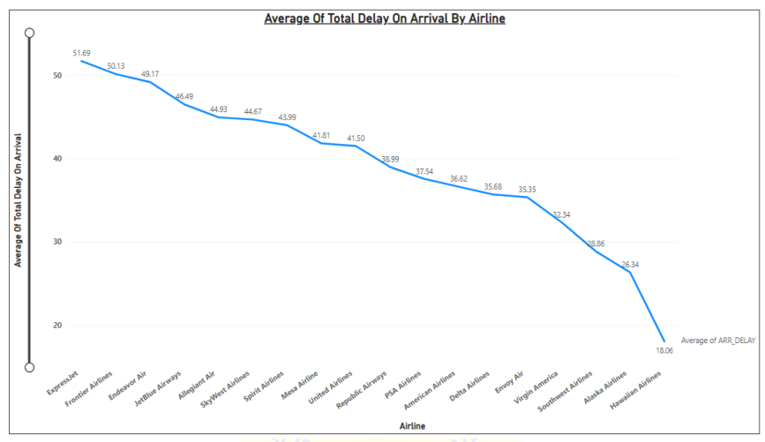
Average Total Delay on Arrival by Airline

Slide 12
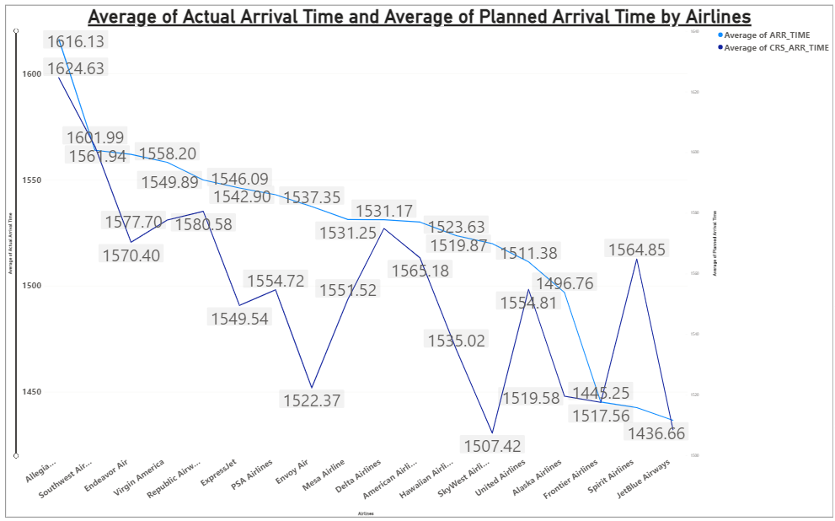
Average of actual arrival time and planed arrival time by Airline

Slide 13
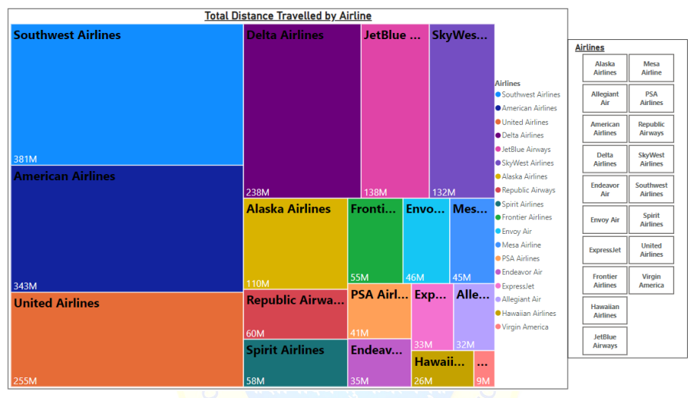
Total Distance Travelled by Airline

Slide 14
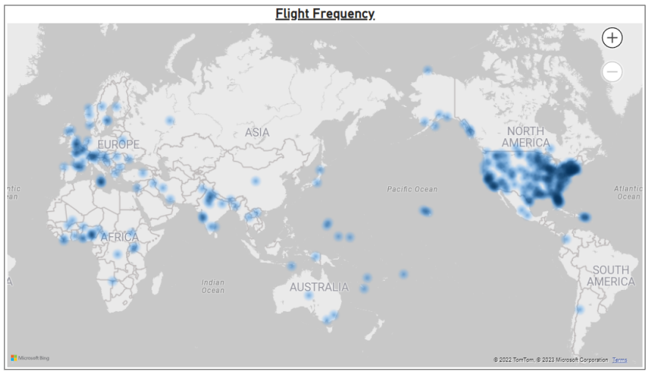
Busiest routes
New York, florida, London, new delhi, paris, malta, hawaii has most number of flights running (so they are busiest route)

Slide 15
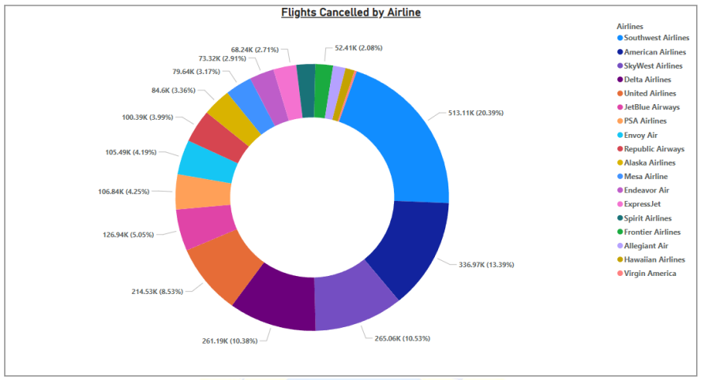
Count of flights cancelled by airline

Slide 16
Machine learning
A number of machine learning algorithms, such as LOGISTIC REGRESSION, DECISION TREE CLASSIFIER, GRADIENT BOOSTING, RANDOM FOREST CLASSIFIER, and SVM, have been tested.
Each model ‘s F1 Score and accuracy score is calculated :
● LOGISTIC REGRESSION = 0.7644
● DECISION TREE CLASSIFIER = 0.7822
● GRADIENT BOOSTING = 0.8215
● RANDOM FOREST CLASSIFIER = 0.7809
● SVM = 0.5000
After trying out several algorithms, the most suitable algorithm for our dataset is the Gradient Boosting which is a basic but excellent algorithm for Binary Classification.

Slide 17
Conclusion
First, an EDA was conducted on the airline dataset to identify patterns and connections.
Preprocessing steps, including feature scaling, indexing categorical variables, and imputing missing values, were taken.
New features were created to enhance the model. Visualizations were used to explore the preprocessed data and identify insights, such as Expressjet having the largest average delay and Southwest Airlines having the highest cancellation rate.
The monsoon season was also identified as the most frequent cause of flight delays.
Finally, classification models, including Logistic Regression, Decision Tree, Gradient Boosting, Random Forest, and SVM, were implemented to predict flight delays in 2018.
The Gradient Boosting model was found to be the most appropriate, with an accuracy rate of 95%.

Slide 18
THANK YOU !!!

